Slide 1
EAC-Barrett’s Microbiome Study: progress to date
Harris-Greathouse Collaboration
01/20/21

Slide 2
Actual
65
88
5
158
These results were from James’ 2019 analysis
But there was a more recent version of the 16S rRNA/WGS...

Slide 3
Greathouse Group
Next steps will focus on:
Q1: Is there a taxonomic signature shared between the Barrett's samples?
NOTE: Only 5 actual Barrett’s samples in NCI dataset, and 27 with history of Barrett’s in TCGA dataset
Q2: What is the abundance of F. nucleatum or Fusobacterium between these samples; BO, BO-EAC, BO-EAC-adjacent?
Q3: Is Fusobacterium associated with tumor stage or prognosis in either data set? (TCGA already confirmed)
Q4: What is the inferred metabolic function of the taxa identified in each dataset
Will run PICRUSt2 and HUMANn 2.0 tools
Q5: Are Camp and Strep in BO and BO-EAC a stronger signature than fuso in these samples?

Slide 4
Greathouse Group
Next steps will focus on:
Q1: Is there a taxonomic signature shared between the Barrett's samples?
Barrett's (BO), tumor-adjacent EAC-w/history of Barrett's, EAC-w/ history of Barrett's
NOTE: Only 5 actual Barrett’s samples in NCI dataset, and 27 with history of Barrett’s in TCGA dataset
Q2: What is the abundance of each taxa of interest between these samples; BO, BO-EAC, BO-EAC-adjacent?

Slide 5
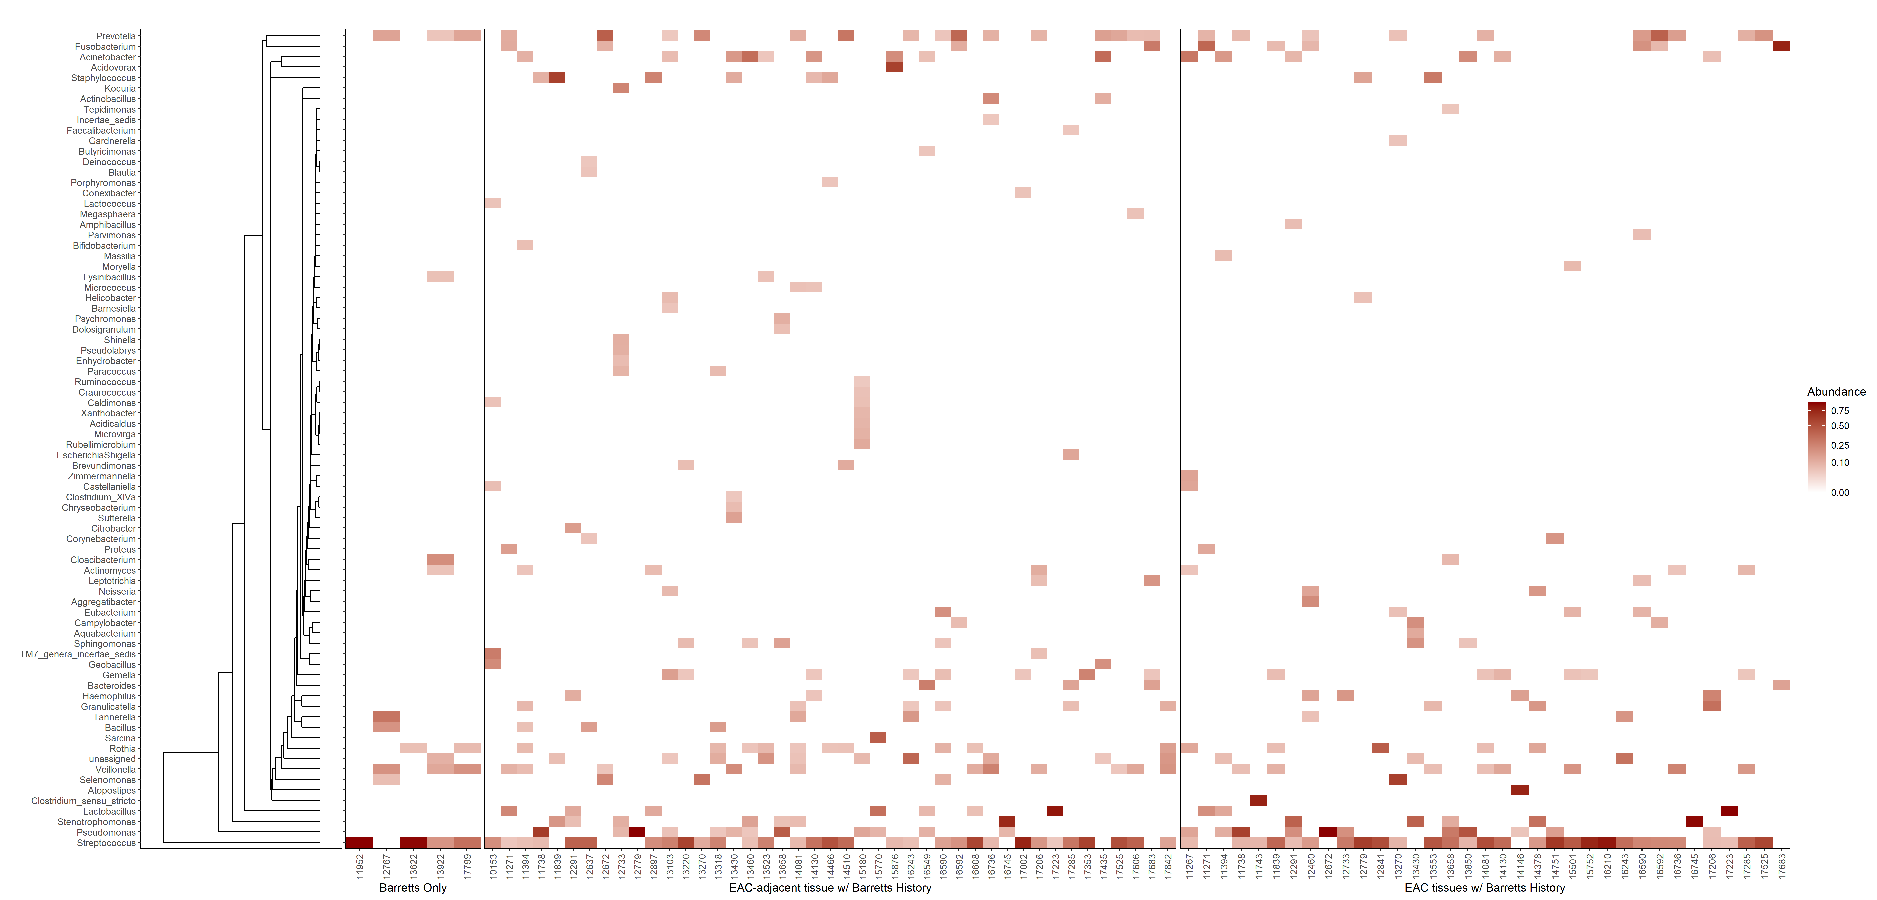
1. Please change this figure threshold to RA >0.01; add dendrogram and color if possible
2. Add second similar figure but with RA >0.05
RA > 0.01
RA > 0.05

Slide 6
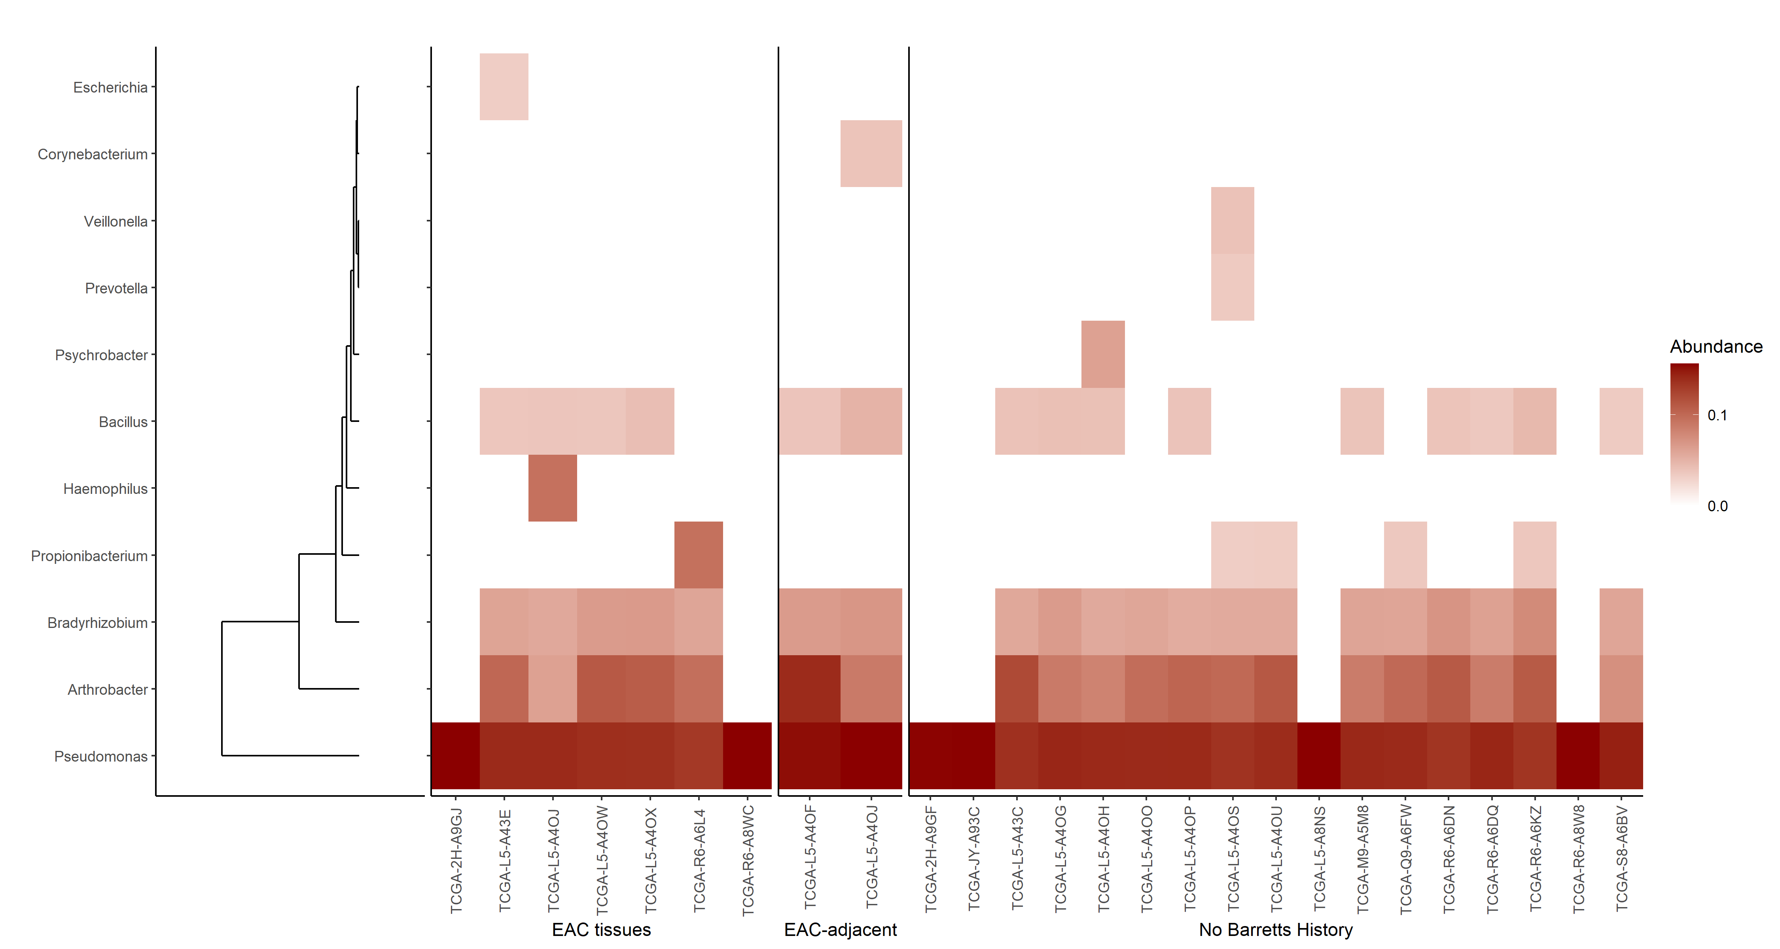
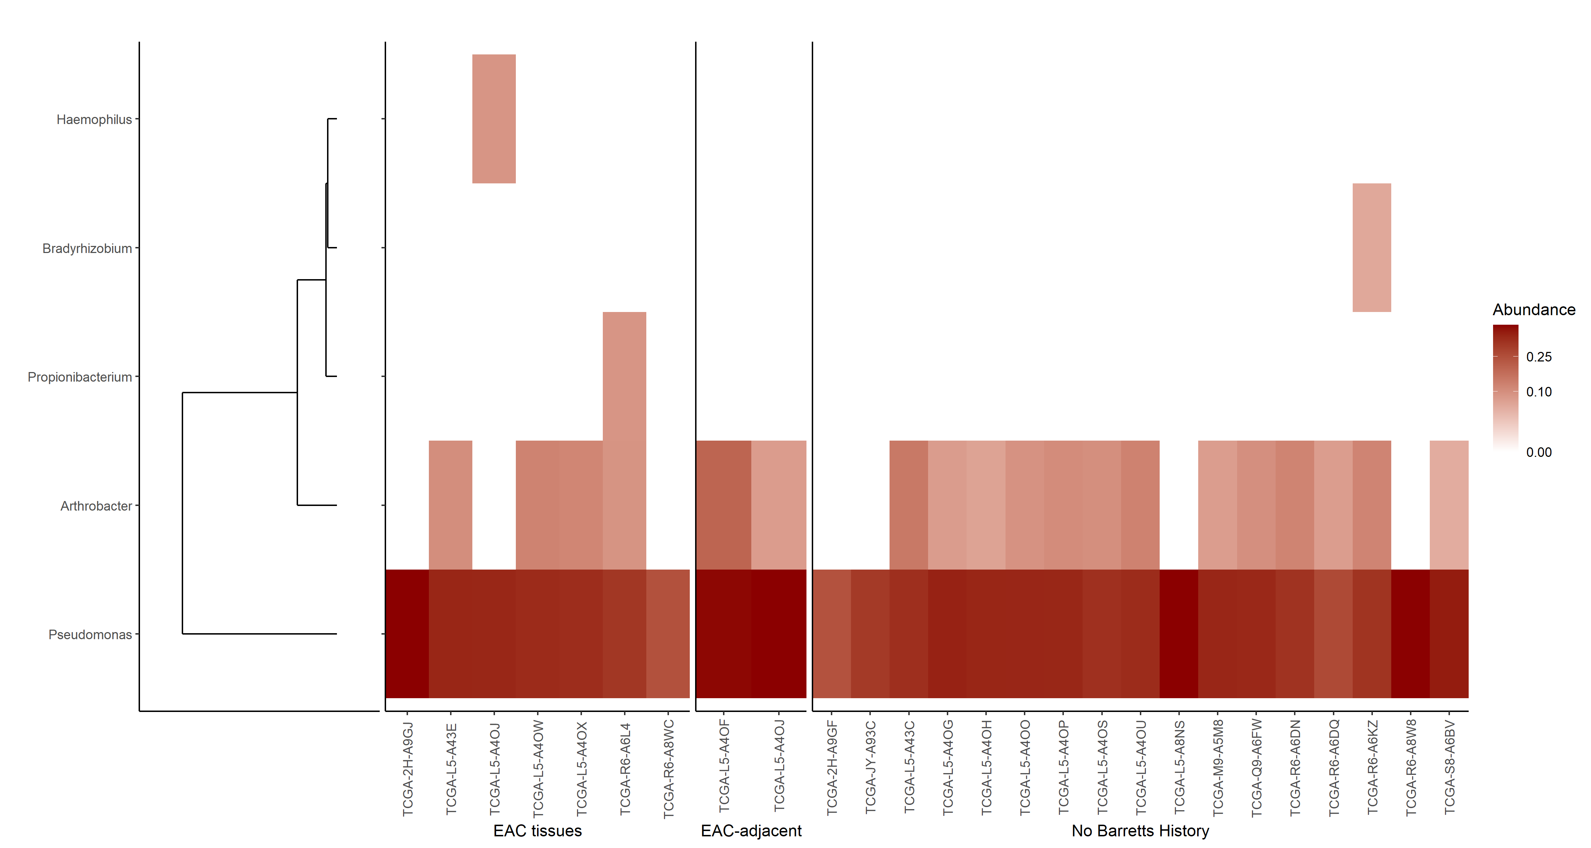
1. Please add third tissue type = EAC tissues w/o Barretts History
2. Please change this figure threshold to RA >0.01; add dendrogram and color if possible
3. Add second similar figure but with RA >0.05
RA > 0.01
RA > 0.05

Slide 7
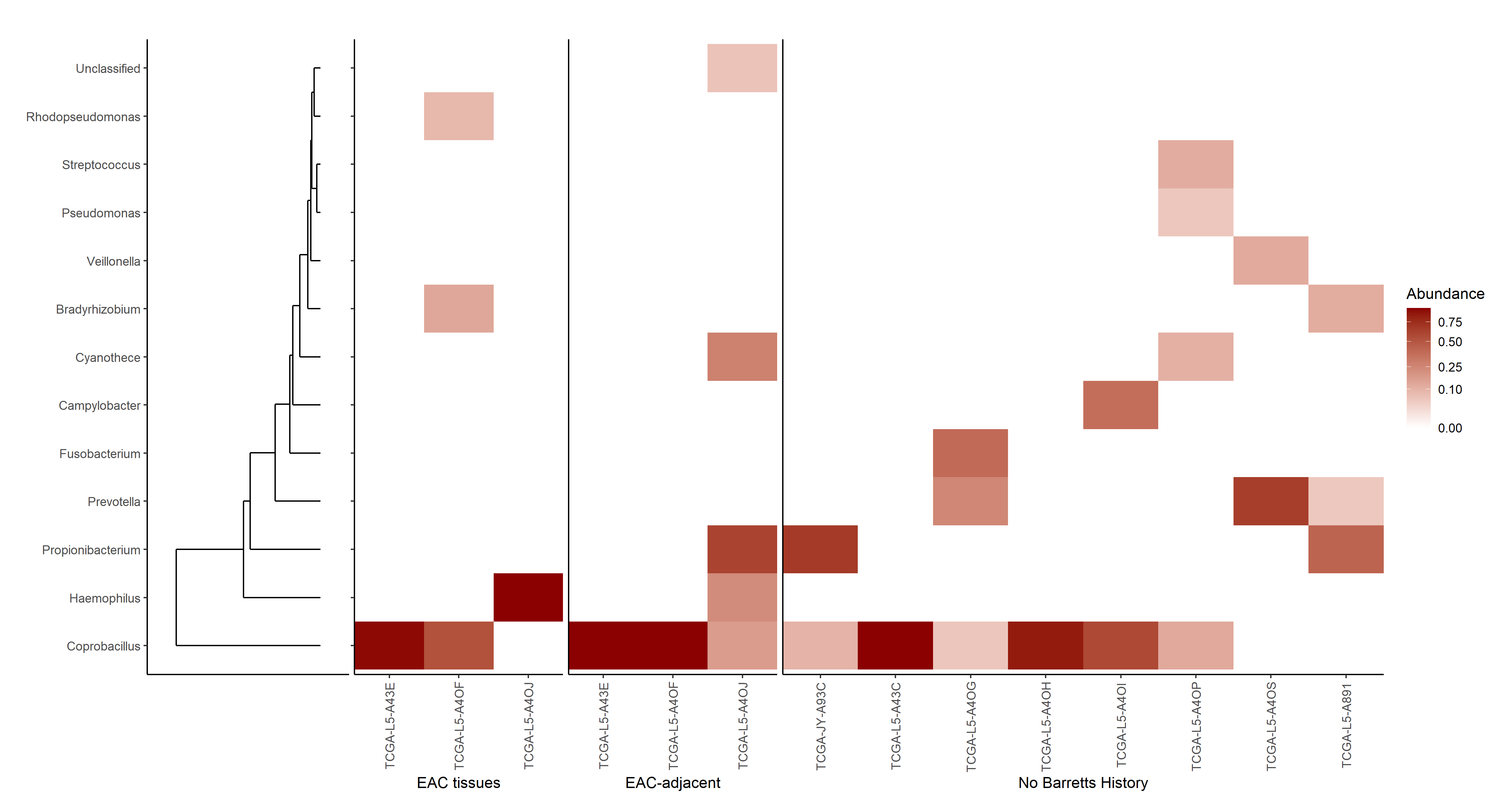
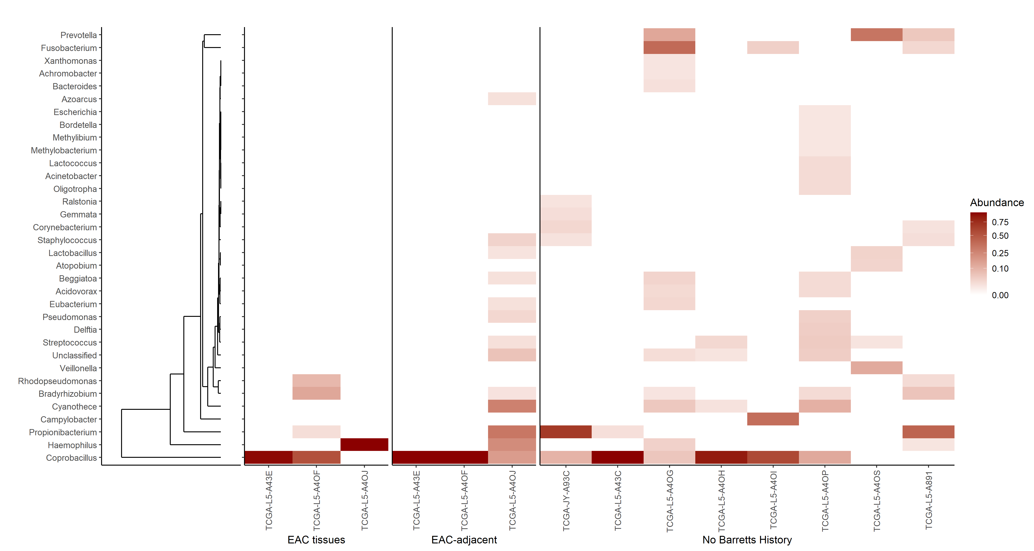
1. Please add third tissue type = EAC tissues w/o Barretts History
2. Please change this figure threshold to RA >0.01; add dendrogram and color if possible
3. Add second similar figure but with RA >0.05
RA > 0.01
RA > 0.05

Slide 8
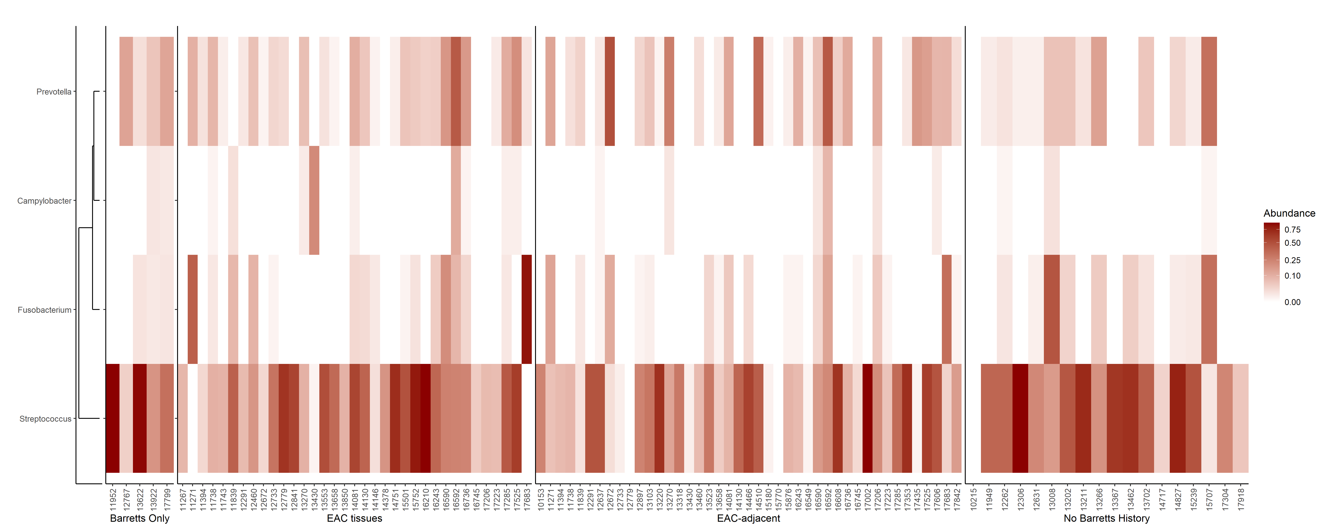
1. Please add fourth tissue type = EAC tissues w/o Barretts History

Slide 9
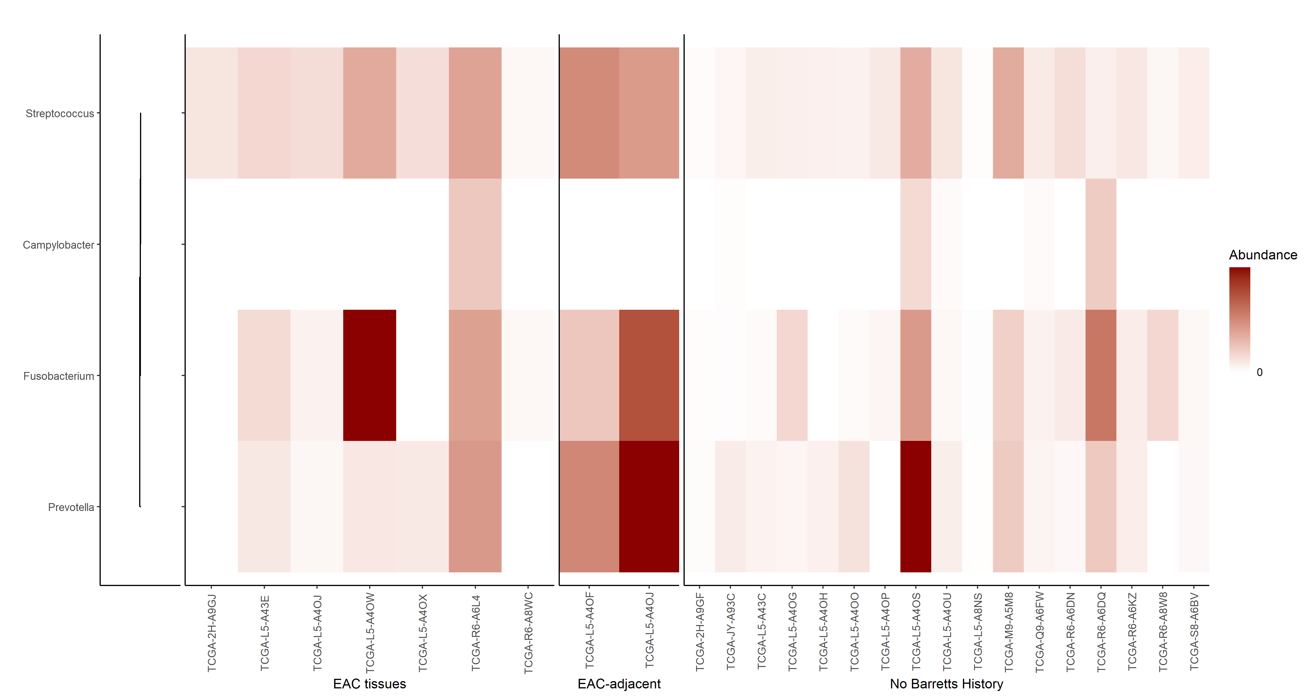
1. Please add third tissue type = EAC tissues w/o Barretts History

Slide 10
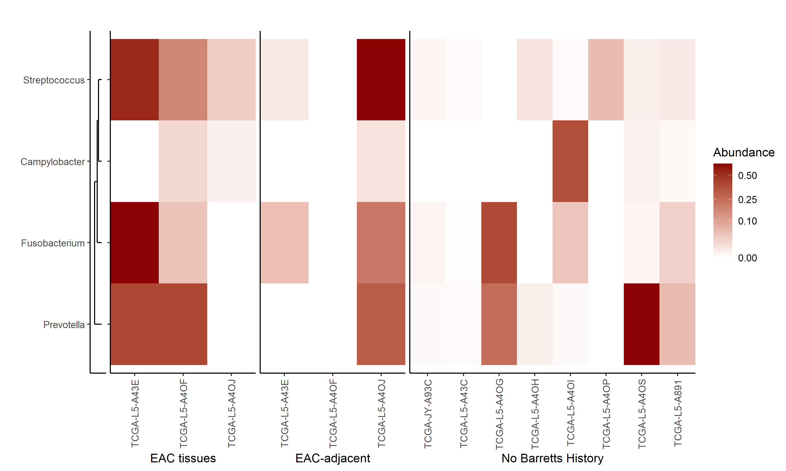
1. Please add third tissue type = EAC tissues w/o Barretts History

Slide 11
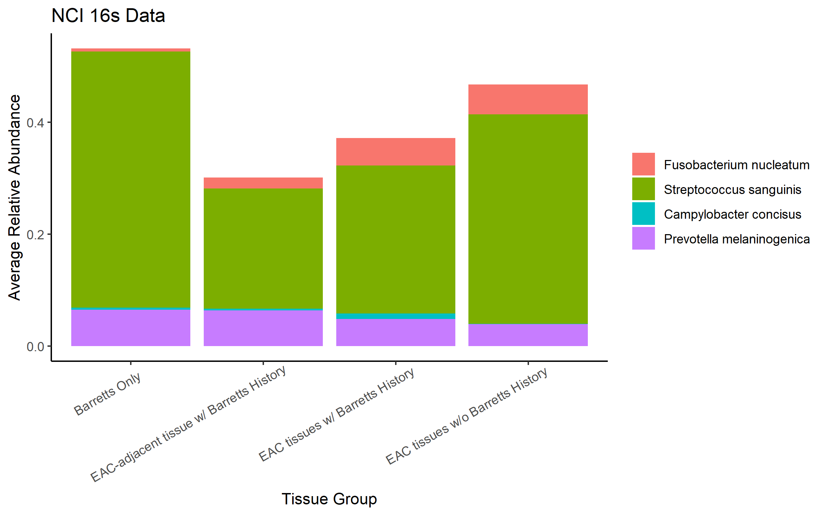
1. Please adjust x-axis to be angled
2. Please add fourth group = EAC w/o Barretts history

Slide 12
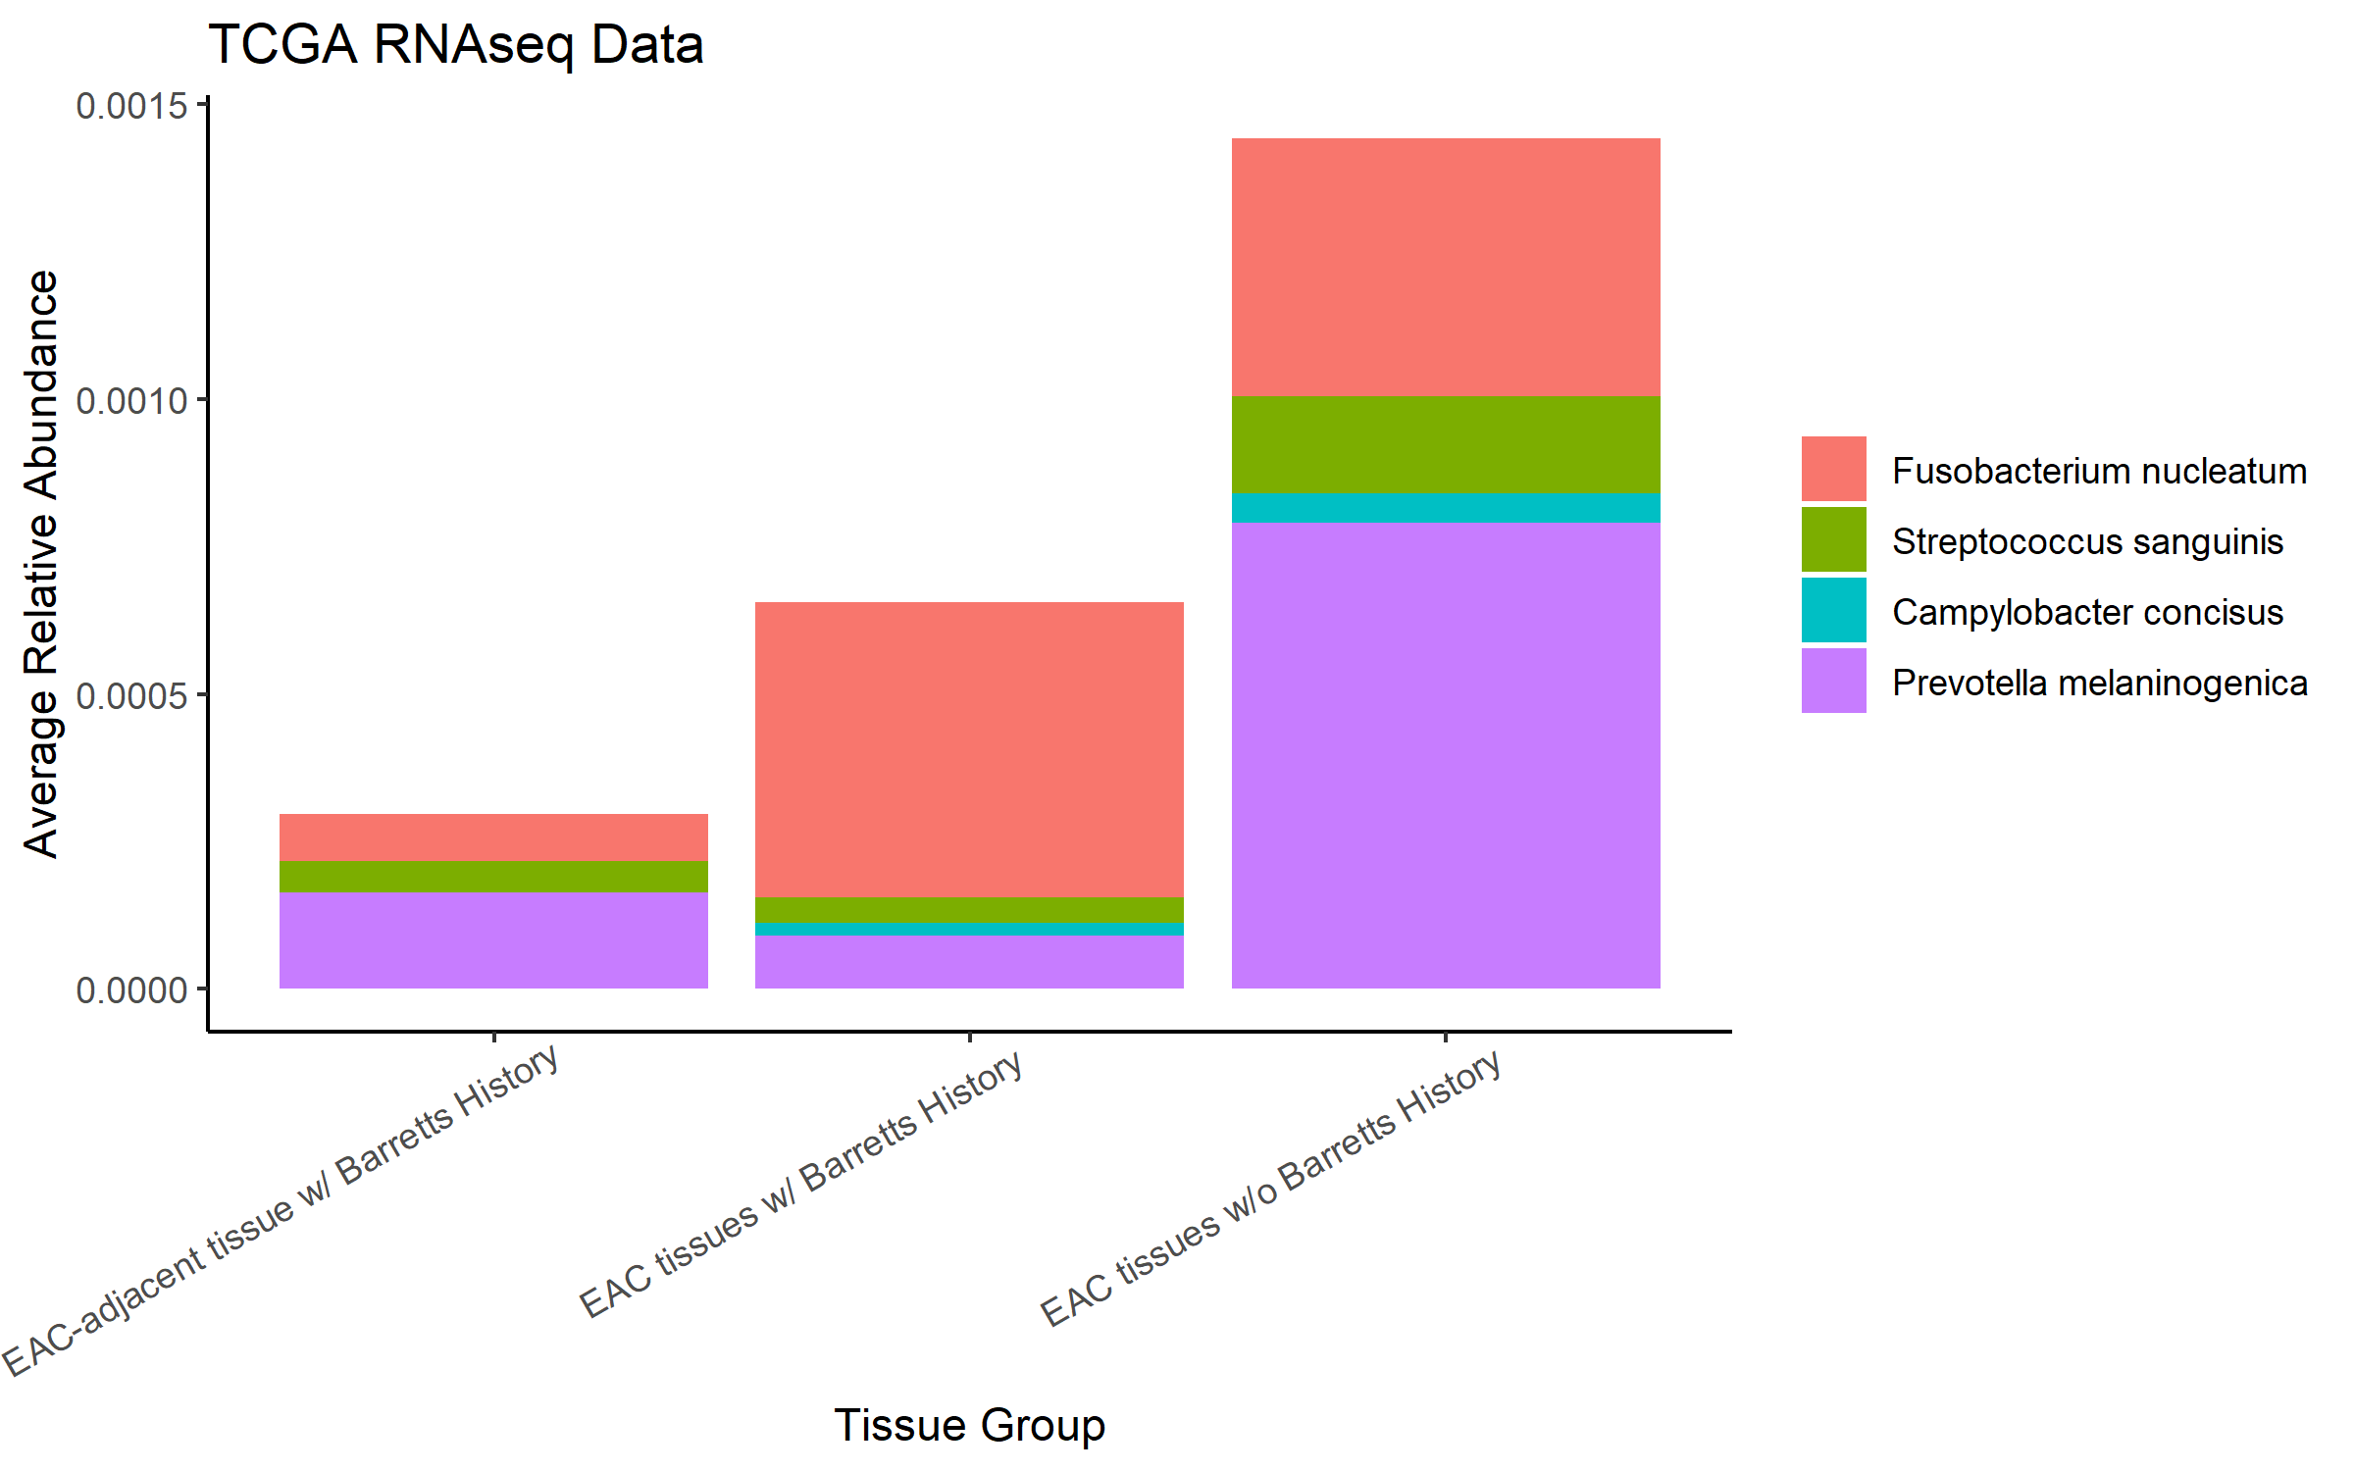
1. Please add third tissue type = EAC tissues w/o Barretts History

Slide 13
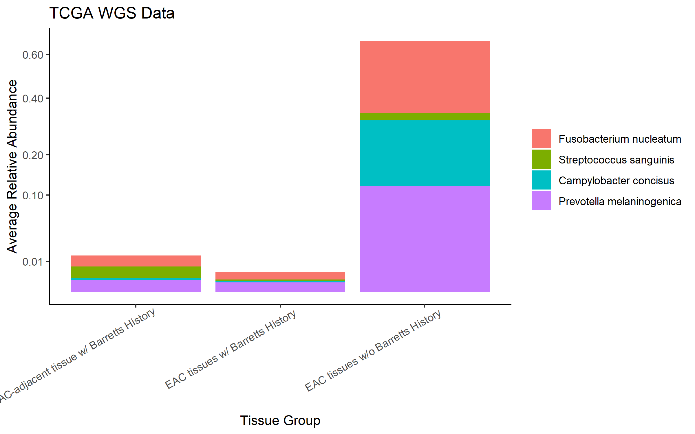
1. Please add third tissue type = EAC-adjacent tissues w/ Barretts History

Slide 14
For the RNAScope we collectively decided to focus on these 4 taxa – Josh will discuss more on this...

Slide 15
Fuso Data Analyses – Curt’s Group
RNAScope – NCI-MD data
Fusobacterium nucleatum
Streptococcus sanguinis
Campylobacter concisus
Prevotella spp.
qRT-PCR – NCI-MD data
CODEFACS – NCI/TCGA data
CIBERSORT – NCI/TCGA data
CD8 Exhaustion signature – NCI/TCGA data

Slide 16
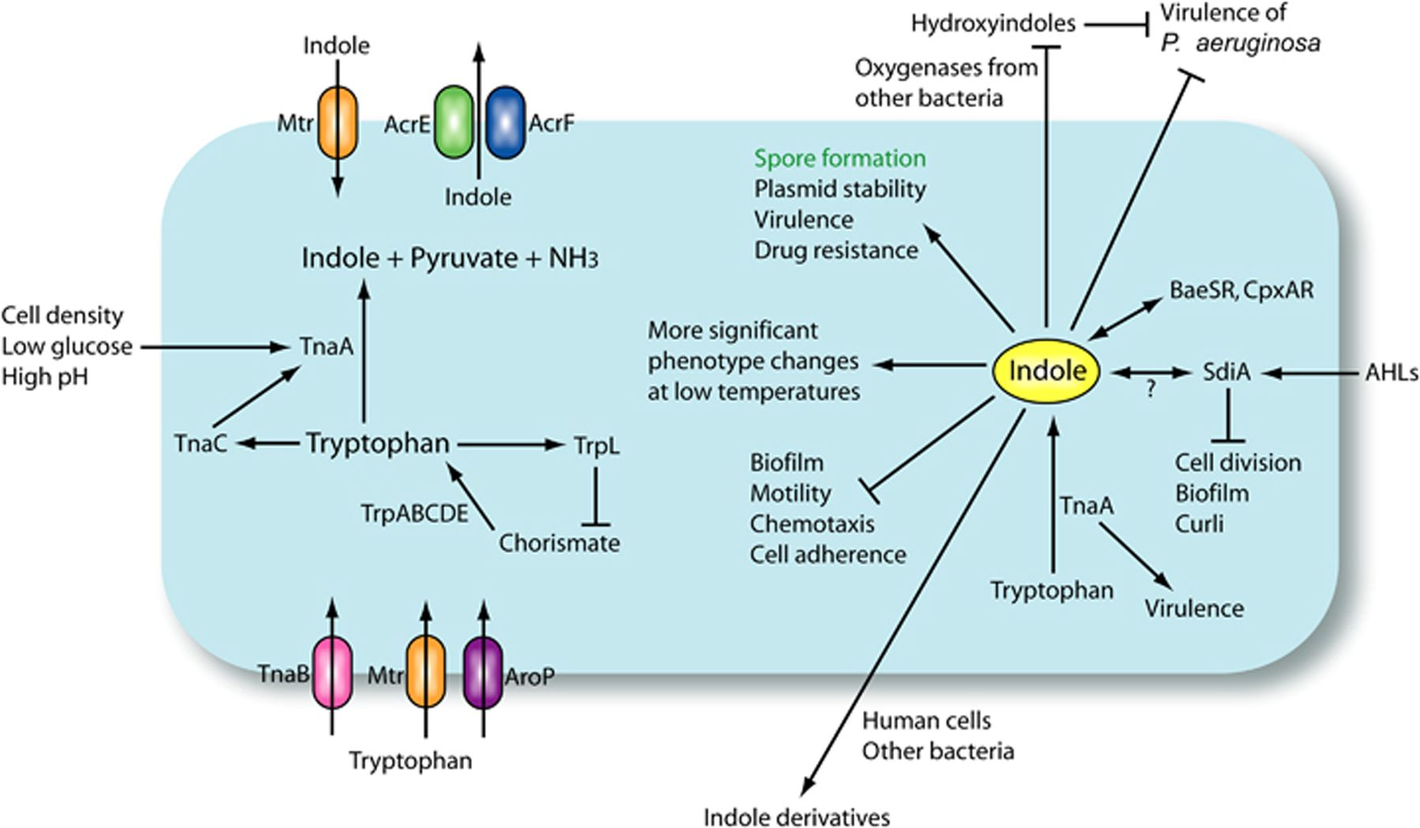
Overview of Trp → Indole metabolism
Biofilm
???
Immune cells absent
Fn - FadA
E-cad loss

Slide 18
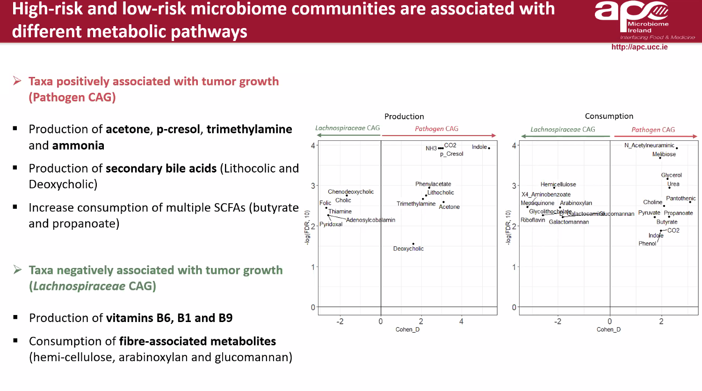
Fibre-associated Lachnospiraceae reduce colon tumorigenesis by modulation of the tumour-immune microenvironment – Dr. Ana Almada (CSHL Microbiome Conference, 2020)

